Slide 1
AUDIOBOOK
Name -Chahat
Roll No. –m 2210990231

Slide 2
Index
Objective
Introduction
Methodology, Approach & Techniques
Source Code (screenshots)
Conclusion

Slide 3
Objective
Accessibility: Creating audiobooks makes content more accessible to people with visual impairments or those who prefer listening to content rather than reading it.
Convenience: Audiobooks provide a convenient way for people to consume content while performing other tasks such as driving, exercising, or doing household chores.
3. Convert Text to Speech: The primary objective is to convert text from a document or text file into human-like speech. This involves using text-to-speech (TTS) libraries or services to generate audio files from textual content.
4. Customization: Audiobook creation in Python allows for customization options such as adjusting the speech rate, voice, language, and formatting of the output audio.

Slide 4
Introduction
In today's fast-paced world, where time is precious and multitasking is the norm, audiobooks have emerged as a popular and convenient way to enjoy literature.
Audiobooks offer a unique experience, allowing listeners to immerse themselves in captivating stories, insightful non-fiction, and educational content while on the go, exercising, or relaxing at home.
Audiobooks bridge the gap between literature and busy lifestyles, enabling individuals to indulge in reading even when traditional methods are impractical.
They promote literacy and lifelong learning by making books accessible to people with visual impairments, those with learning disabilities, and individuals who struggle with traditional reading.
In an increasingly digital world, audiobooks offer a valuable alternative to screen-based entertainment, providing a screen-free and restorative way to consume content.

Slide 5
Methodology, Approach & Techniques
Parallel Processing**: * Discuss the use of parallel processing techniques to speed up the text-to-speech conversion process, especially for large volumes of text.
Parallel Processing**: * Discuss the use of parallel processing techniques to speed up the text-to-speech conversion process, especially for large volumes of text.
Text-To-Speech Conversion:
Utilize Python libraries such as `pyttsx3` to convert text into spoken audio.
Explore the process of converting textual content from documents or files into human-like speech.
Voice Customization:
Explore techniques for customizing the voice and speech characteristics of the generated audiobooks, such as adjusting the pitch, speed, and accent.
Python libraries like `pyttsx3` allow for fine-tuning of voice parameters to achieve desired audio quality.
Integration with External APIs:
Explore the integration of external APIs, such as speech recognition APIs, to enhance the functionality of audiobook creation scripts.
Parallel Processing:
Discuss the use of parallel processing techniques to speed up the text-to-speech conversion process, especially for large volumes of text.

Slide 6
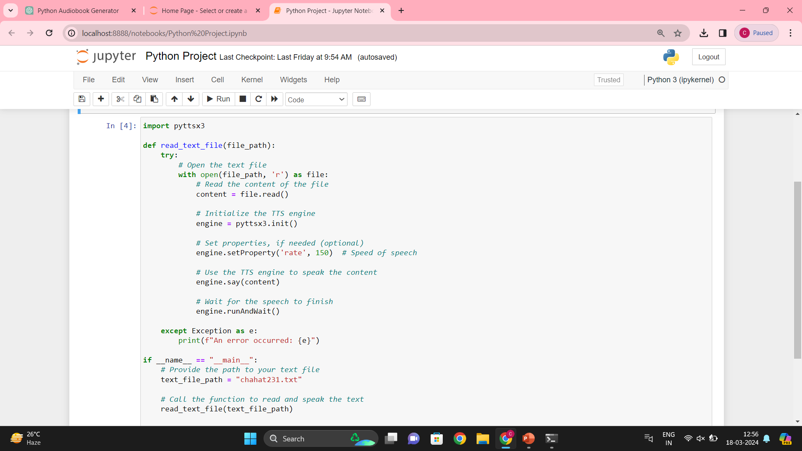
Source Code (Screenshots)

Slide 7
Conclusion
In conclusion, audiobook creation in Python represents a powerful intersection of technology and accessibility, empowering individuals to enjoy literature in new and inclusive ways. Through innovative text-to-speech conversion, automation, and community collaboration, we have demonstrated the potential of Python to democratize access to knowledge and storytelling. As we continue to explore new techniques and engage with diverse audiences, we are committed to advancing the audiobook industry and fostering a culture of lifelong learning and connection. Thank you for joining us on this journey.

Slide 8
The End

